Slide 1
April,2021
Biomedical Committee – Biomedical Equipment Starter Pack
Session (5) : Nuclear Imaging - Plainer scintigraphy
(Gamma Camera - PET - SPECT)
Prepared by: Mohamed Ahmed Abdelaziz

Slide 2
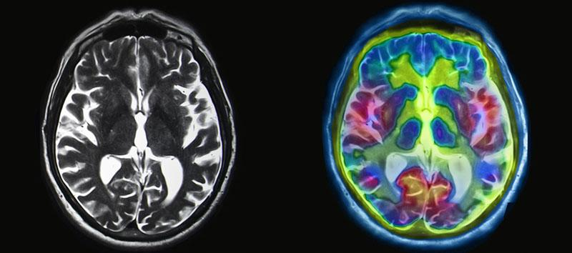
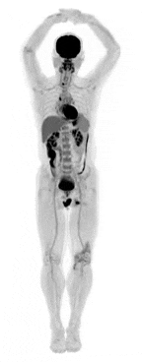
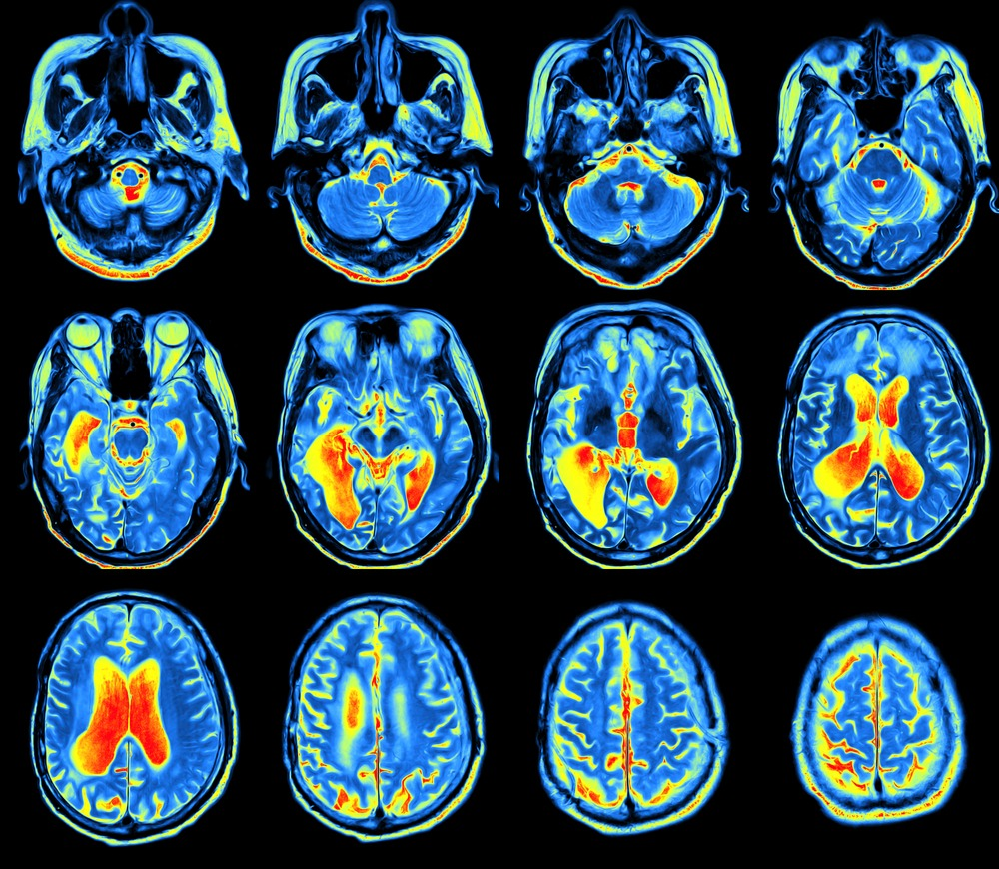
Nuclear Medicine
Nuclear medicine scans a very small amount (e.g., nanograms or picograms) of radioactive material called a radiotracer that is injected intravenously into the patient
Agent then accumulates in specific organs in the body
Speed, amount, position of this accumulation are factors which can determine whether tissue is healthy or diseased.
Plain scintigraphy
PET
SPECT

Slide 3

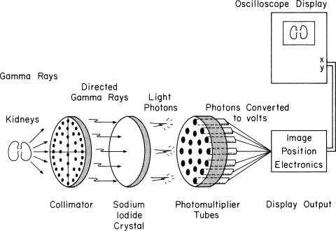
Nuclear Imaging Characteristics
Poor SNR
Low spatial resolution (~5–10 mm)
Slow image acquisition
Extremely high sensitivity
Very high specificity (no natural radioactivity from the a body)
Provide functional characteristics of the information acontent of the images

Slide 4
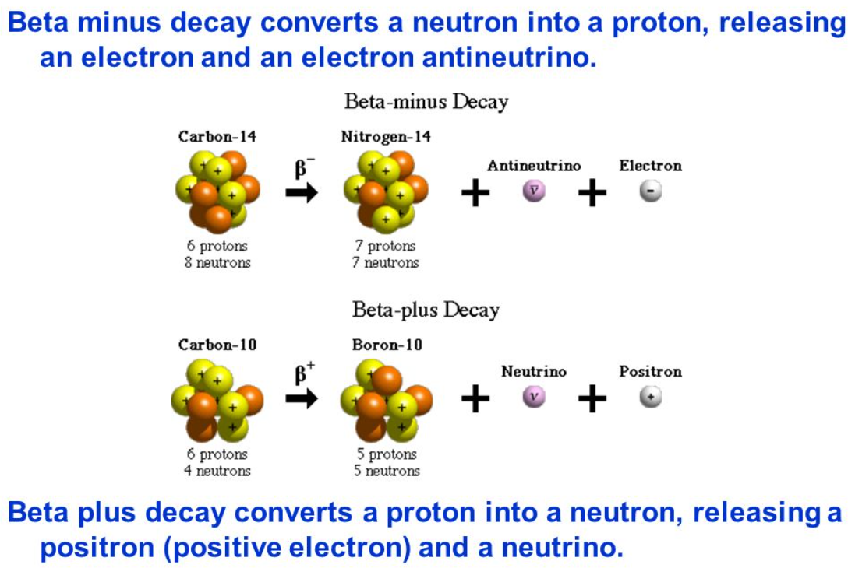
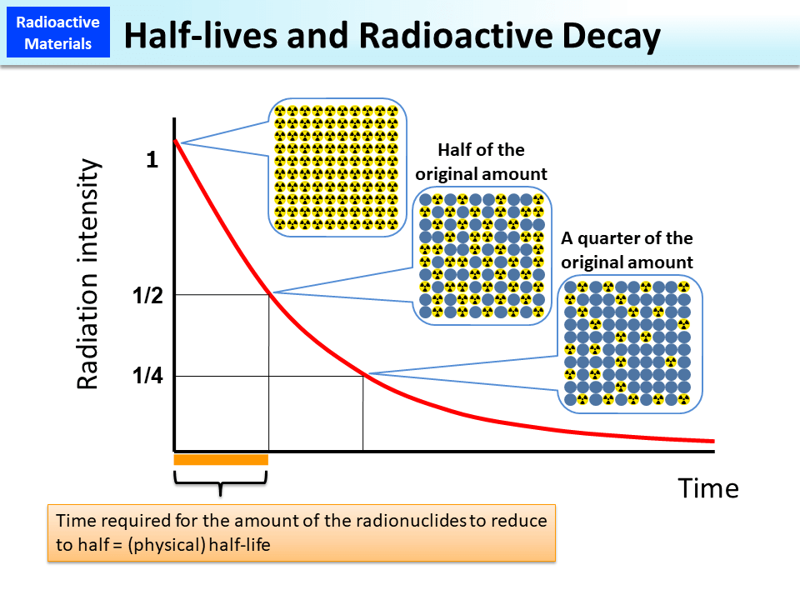
Radioactivity
A radioactive isotope undergoes disintegration
Half-Life Time (τ½): is time required for the radioactivity to drop to one-half of its value
Effective Half-Life (τ_{½,eff}) is a combination of Biological half-life (τ_{½,bio}) and Half-Life Time (τ½)

Slide 5
Properties of Ideal Radiotracers
Short enough half-life to produce significant radioactivity without requiring a very large initial dose.
Not so short to allow the radiotracer to distribute in the relevant organs.
Mono-energetic γ-ray emission without emission of alpha- or beta-particles.
The radiotracer should have a high uptake in the organ of interest and relatively low non-specific uptake in the rest of the body (Lower the dose – Improve the contrast) .
Allows discrimination between Compton scattered and un-scattered γ-rays, thereby improving image contrast.
Alpha- or beta-particles are completely absorbed within tissue, therefore increasing the radioactive dose without giving any useful image information.
The energy of the γ-ray should be greater than ~100 keV to have sufficient energy to travel through the body and reach the detector.
The energy of the γ-ray should be less than ~200 keV so that the rays do not penetrate the thin lead septa in the collimator (which is analogous to the anti-scatter grid in X-ray imaging).

Slide 6
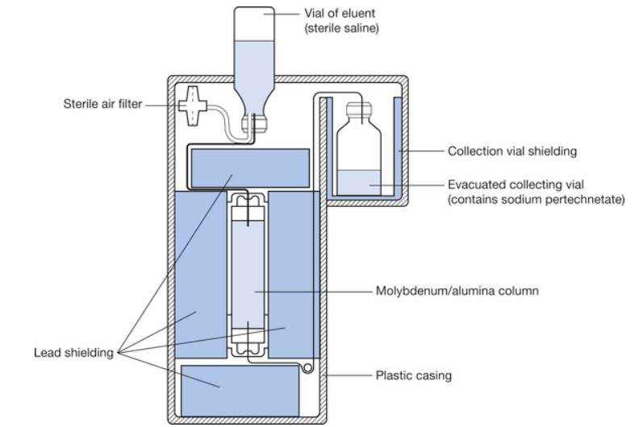
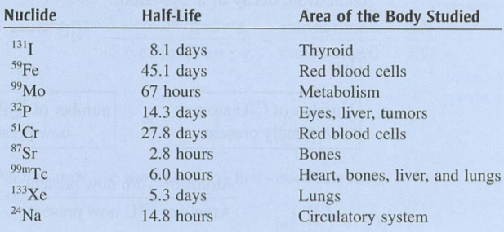
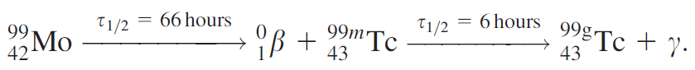
Technetium Generator
Most widely used radiotracer in of planar scintigraphy and SPECT studies is ^{99m}Tc
It exists in a metastable state (one with a reasonably long half-life)
Energy of the emitted γ-ray is 140 keV

Slide 7
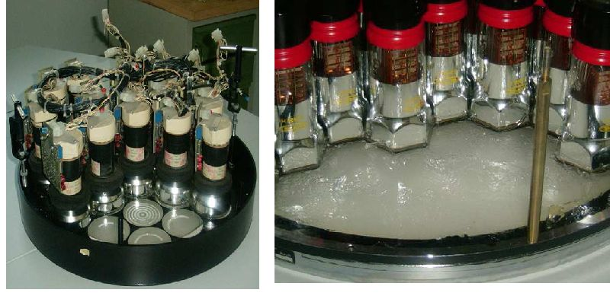
Scintillation Crystal & Photomultiplier Tube
In the gamma camera, the detector is a large single crystal of thallium-activated sodium iodide, NaI(Tl). The crystal is excited when a γ-ray strikes it.
De-excitation of these states takes ~230 nanoseconds via emission of photons with a wavelength of 415 nm (visible blue light)
Arrays of 61, 75 or 91 PMTs are typically used
For planar nuclear medicine scans, a variation in uniformity of up to 10% can be tolerated whereas only values less than 1% can be tolerated in SPECT

Slide 8
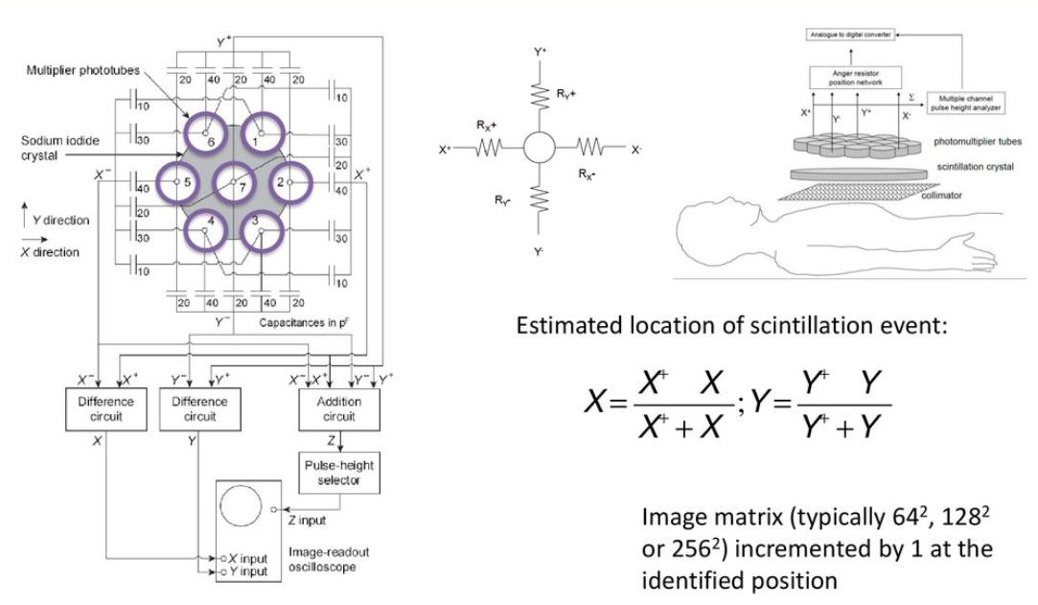
Anger Position Network & Pulse Height Analyzer
When a scintillation event occurs the PMT closest to the scintillation event produces the largest output current., then the spatial resolution would be no finer than dimensions of the PMT.
Adjacent PMTs produce smaller output currents. By comparing the magnitudes of the currents from all the PMTs, the location of the scintillation within the crystal can be much better estimated
PHA determine which of the recorded events correspond to γ-rays that have not been scattered within and which have been Compton scattered in the patient (do not contain any useful spatial information) and so should be rejected.

Slide 9
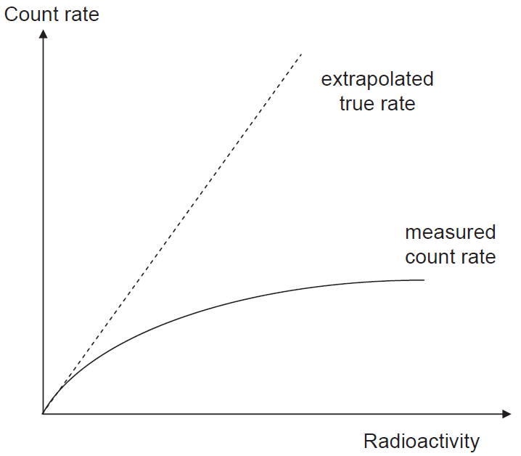
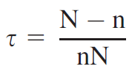
Instrument Dead Time
If the total number of γ-rays striking the scintillation crystal exceed the recording capabilities of the system.
Limitation is due to the finite recovery and reset times required for various electronic circuits.
Two types of behavior exhibited by the system components, termed
paralysable
If another γ-ray strikes same spot in the crystal before the excited state decays, then it will take a further 230 ns to decay, and only one set of photons will be produced even though two γ-rays have struck the crystal. High rate of γ-rays; elongated dead-time.
non-paralysable
component cannot respond for a set time.
Anger logic circuit and PHA take a certain time to process
a given electrical input signal, and during this time any
further events are simply not recorded.
Correction (N:True count, n:measured rate)

Slide 10
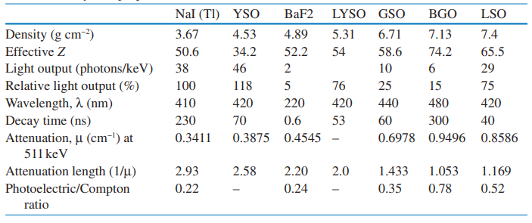
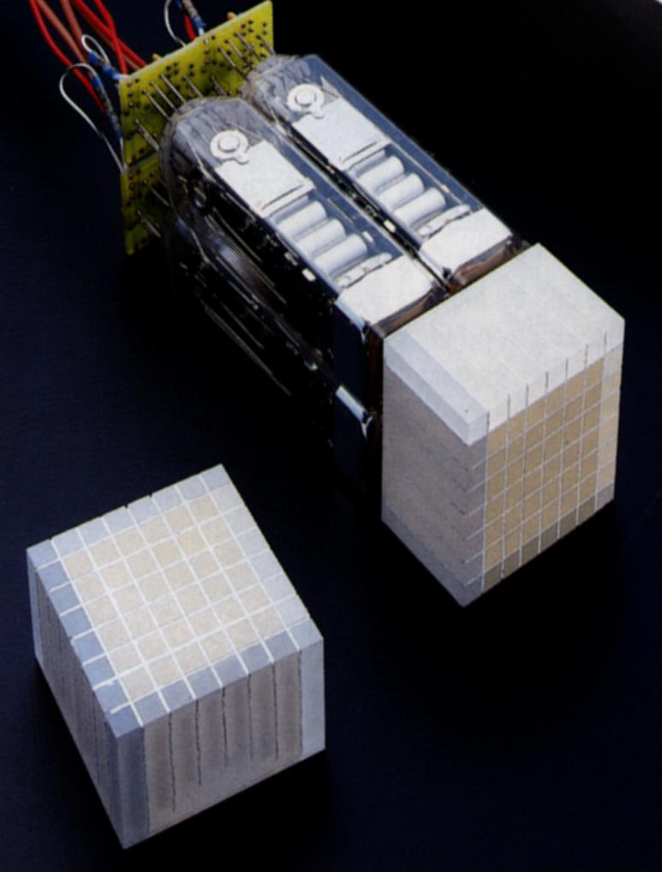
PET & SPECT Radiation Detectors
Scintillation Detector: The photoelectric effect is the primary mode of interaction of photons with the atoms in the crystal.
The most important properties of a detector:
The Stopping Power: A crystal with shorter attenuation length will have higher efficiency and sensitivity.
High Light Output: Will lead to good energy resolution.
Short Decay Time: Will lead to higher counting rates with minimum dead time.
High Energy Resolution: A crystal with high energy resolution can reject scattered photons more effectively.
Energy Resolution is more important for SPECT scanners. [ NaI(TI) ]
Stopping Power is more important for PET scanners that can interact with 511-keV photons. [ BGO and LSO ]

Slide 11
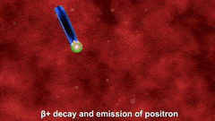
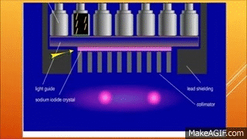
Radioactive Tracers
Radioactive tracers are made up of carrier molecules that are bonded tightly to a radioactive atom. These carrier molecules vary greatly depending on the purpose of the scan.
The radioactive tracer is administered to a patient by intravenous injection, inhalation, oral ingestion, or by direct injection into an organ.
The main difference between SPECT and PET scans is the type of radiotracers used.
SPECT: measure gamma rays from the decaying atoms such as [technetium-99m or iodine-123].
PET: PET radiotracers produce small particles called positrons which react with electrons in the body and annihilation occurs [fluorodeoxyglucose (FDG), radioactive oxygen, carbon, nitrogen, or gallium.].

Slide 12
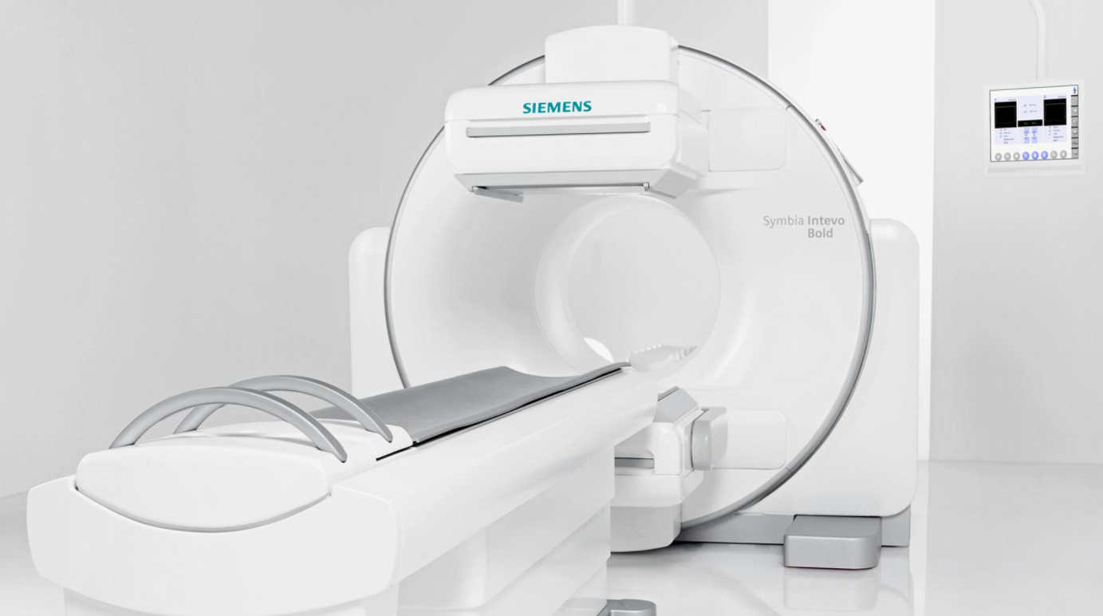
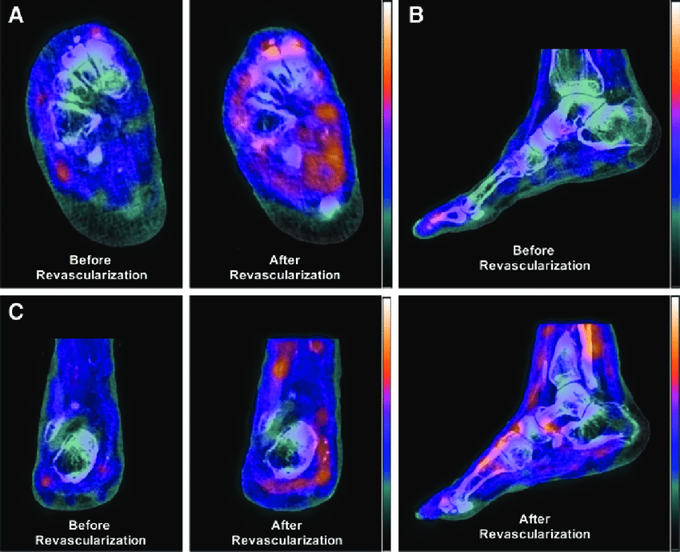
SPECT
A single-photon emission computerized tomography (SPECT) scan lets your doctor analyze the function of some of your internal organs how
blood flows to your heart or what areas of your brain are more active or less active. It uses a radioactive substance and a special camera
to create 3-D pictures.
SPECT is used For:
Brain disorders [Dementia, Clogged blood vessels, Seizures, Epilepsy]
Heart problems [Clogged coronary arteries, Reduced pumping efficiency]
Bone disorders [diagnose hidden bone fractures, track the progression of cancer.
Risks
Rarely, an allergic reaction to the radioactive tracer
SPECT scans aren't safe for women who are pregnant or breast-feeding because the radioactive tracer may be passed to the developing fetus
or the nursing baby

Slide 13
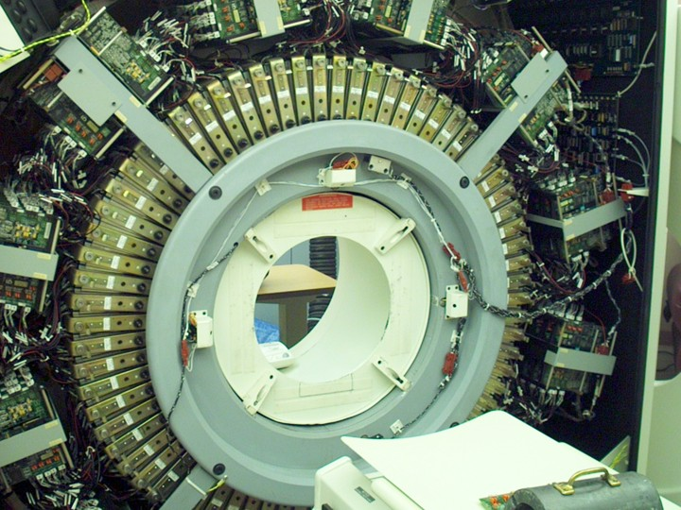
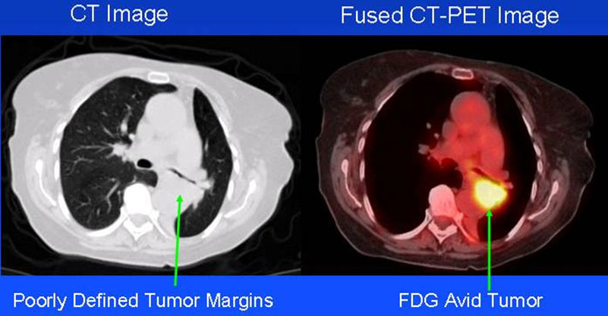
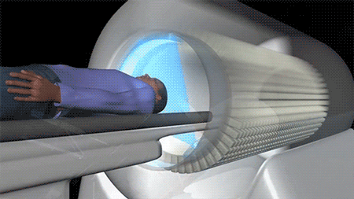
PET
A positron emission tomography (PET) scan is an imaging test that helps reveal how your tissues and organs are functioning. A PET scan uses a radioactive drug (tracer) to show this activity. This scan can sometimes detect disease before it shows up on other imaging tests.
The tracer collects in areas of your body that have higher levels of chemical activity,
Note: Whole-body emission scan represents a series of static scans performed at different segments or portions of the whole body a FOV of 15–20 cm. Typically, five to seven bed positions, each requiring 3–5 min, will complete a body emission scan from head to midthighs in 15–35 min.
PET is used For:
Detecting Cancer: cancer cells have higher metabolic rate than normal cells Brain.
Heart disease: reveal areas of decreased blood flow in the heart.
Brain disorders:[tumors, Alzheimer's disease and seizures].
Risks ( similar to SPECT Scan)

Slide 14
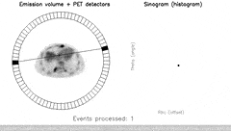
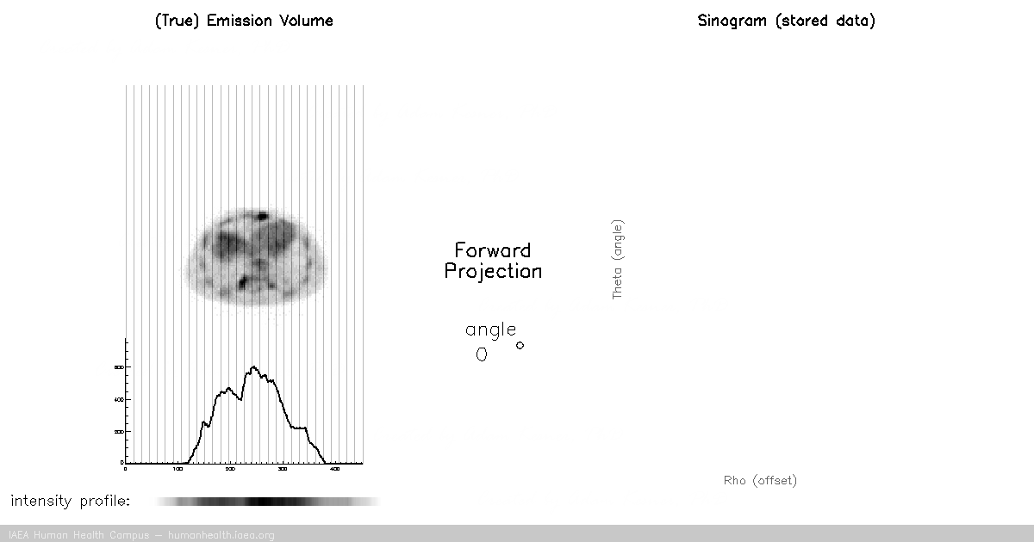
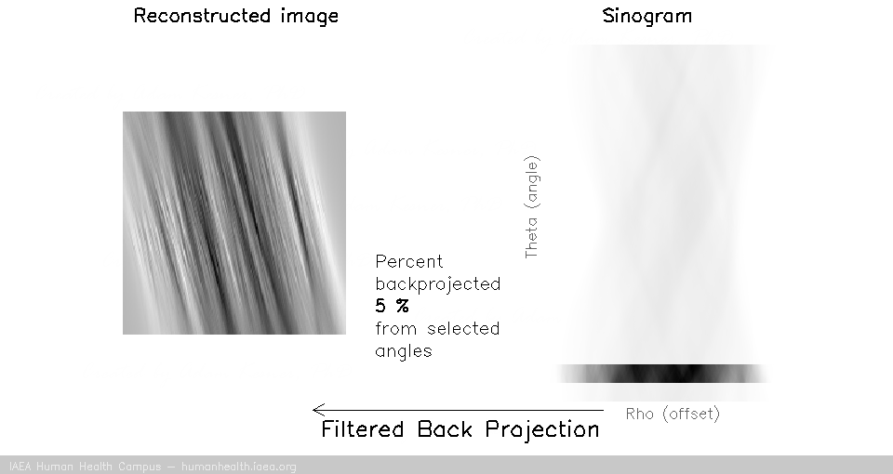
Positron Annihilation and Coincidence Detection
A positron ejected by a radionuclide travels a very short distance in a tissue, affect spatial resolution, dissipating its kinetic energy in collisions with electrons to form a positronium. The subsequent positron–electron annihilation results in the emission of two 511-keV photons, 180° apart.
A PET scanner is designed to detect this pair of annihilation photons almost simultaneously with a process called
annihilation coincidence detection (ACD), which establishes the trajectories of detected photons or lines of response (LOR).
Time of Flight method, measuring the difference in arrival time of the two annihilation photons at the opposite detectors helps to determine the exact location of the annihilation event along the LOR.

Slide 15
Thanks

Slide 16
Mohamed Ahmed Abdelaziz
Systems And Biomedical
Engineering Department
3rd Year
Cairo University
(+20)01552516133
Mohamed.ahmed997@eng-st.cu.edu.eg

